Slide 1

E-Commerce Customer Behavior Analysis
Executive Briefing
Submitted : 20 May 2026
Exploring Customer Purchase Patterns, Interaction and Return Behavior
Analysis & Presented By
Yamin Wasi Data Analyst
Contact & Portfolio
LinkedIn Profile : Click Here
Github Portfolio : Click Here
Mail : analyticswasi31@gmail.com

Slide 2
Tools Uses : Python , SQL, Power BI
AGENDA
Customer Demographics Overview
Purchase Amount Behavior
Product Category Performance
Subscription & Payment Analysis
Discount Impact Analysis
Website Engagement Analysis
Customer Satisfaction Analysis
Return Customer Analysis
Location & Delivery Analysis
Key Findings

Slide 3
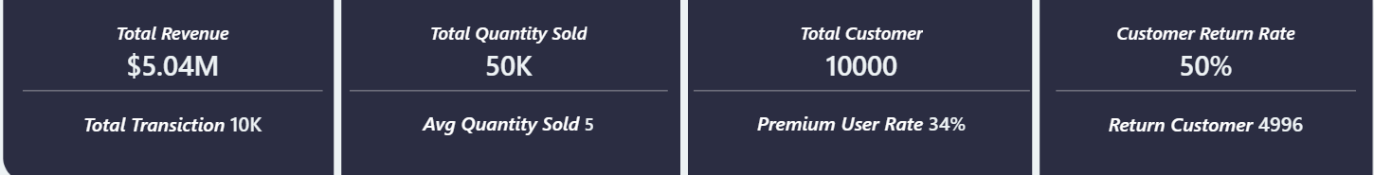
Business Overview & Key Objectives
This e-commerce dataset encompasses 10,000 customers and 10,000 transactions, generating a total revenue of $5.04 million across 8 product categories. A cumulative 49,985 items were purchased approximately 50,000 units in total reflecting an average basket size of 5 items per transaction. Notably 4,996 customers (50%) are classified as return buyers, indicating a stable loyalty base where one in every two customers makes a repeat purchase. With a Premium subscription rate of 34%, the business demonstrates a growing paid user segment with significant potential for subscription-driven revenue growth.

Slide 4
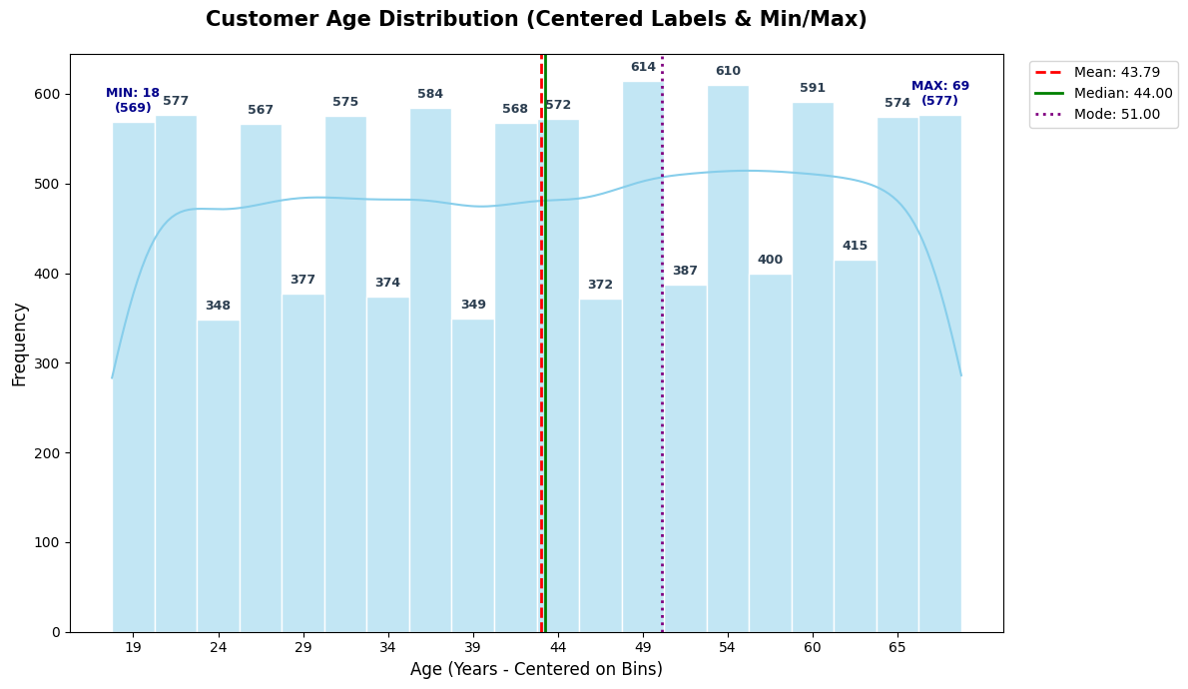
Customer Demographics Overview → Mean, Median, and Mode (Age)
Age range spans 18 to 69 years (51-year spread) with 10,000 customers distributed across all age brackets
Mean age = 43.79 years | Median = 44 years | Mode = 51 years — Mean and Median nearly identical confirming near-symmetric distribution
Mode age 51 represents the most common customer profile with the 49-51 bracket recording the highest frequency of 614 customers — the absolute peak of the distribution
KDE curve recovers and climbs steadily through 34-44 range (374-572 customers) → crosses mean line at 43.79 years → reaches absolute peak at 49-51 (614 customers)
Following the peak KDE curve descends progressively through 54-69 range (387-577 customers) ending at lowest density near age 69 (577 customers).
Frequency range across all bins = 348 to 614 customers — a difference of only 266 customers across the entire 51-year age range confirming near-uniform distribution.
Business implication → Average age of 43.79 years indicates a financially mature, established customer base with stable income and deliberate buying behavior.
Mode age 51 combined with 50% return rate confirms a brand-conscious, loyalty-driven consumer segment with strong repeat purchase potential.

Slide 5
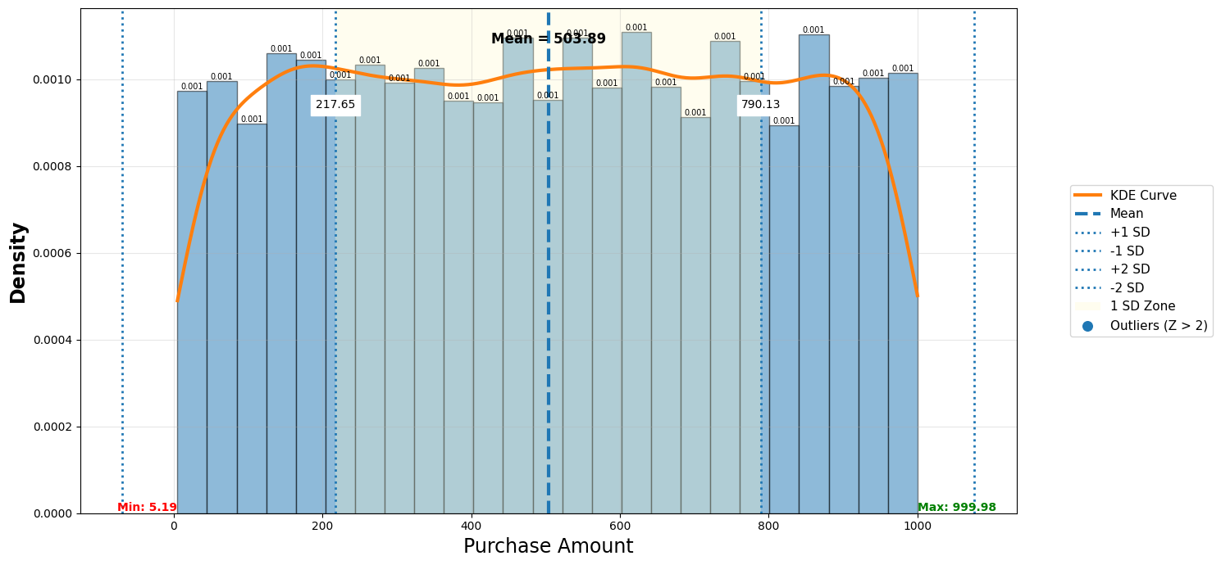
Purchase Amount Behavior

Slide 6
Purchase Amount Behavior
Customer spending ranges from very low (≈5) to very high (≈99.98), which shows that the business serves different types of customers (low, medium, and high spenders).
Mean = $503.89 sits almost perfectly at the center of the distribution — confirmed by the dashed blue mean line at the midpoint of the X axis indicating near-perfect symmetry.
Every histogram bar shows identical density of 0.001 — from $0 to $1,000 all bars maintain virtually the same height — confirming a perfectly uniform distribution where every spending level is equally likely.
−1 SD boundary = $217.65 and +1 SD boundary = $790.13 — a spread of $572.48 — indicating extremely wide customer spending variance of $286.24 standard deviation.
Zero outliers detected beyond Z-score ±2 Which is means no VIP or whale customers exist.
Pricing tiers should be built around IQR ($255—$749) — this is where 50% of customers naturally spend — any product priced within this band has the highest probability of conversion — products below $255 or above $749 require additional marketing justification.
Average spend of $503.89 per transaction is the business baseline — any marketing campaign, discount offer or loyalty programme should target lifting customers above this threshold — even a 10% uplift per customer would add $50 per transaction × 10,000 customers = $500,000 additional annual revenue.

Slide 7
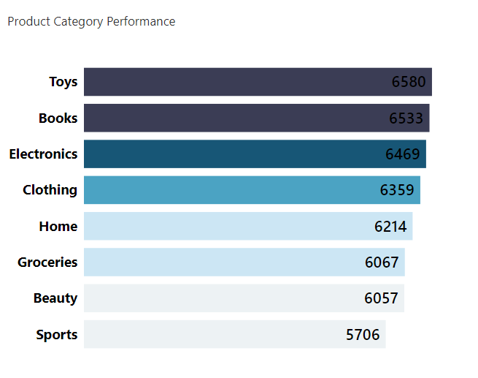
Product Category Performance
Toys Leads the Volume: The top-performing category is Toys with 6,580 purchases, holding a slight edge at the top of the chart.
Stable Mid-Tier Performers: Categories like Books (6,533), Electronics (6,469), and Clothing (6,359) follow in a highly competitive, tight cluster.
Sports Trails the Pack: The lowest-performing category is Sports with 5,706 purchases, marking the only category to dip below the 6,000 threshold.
Extremely Tight Variance: Across a total volume of 49985 purchases spread among 8 categories, the maximum gap between the highest-performing category (Toys: 6,580) and the lowest (Sports: 5,706) is only 874 purchases.
No Standout Flagship Category: Because Purchase volumes are split so evenly across the board, the business cannot rely on a single "hero product category" to drive revenue or customer acquisition.
Since consumer interest is spread evenly across diverse segment from Toys to Sports promotional campaigns and cross-selling bundles have a uniformly high probability of engagement regardless of the target category.

Slide 8
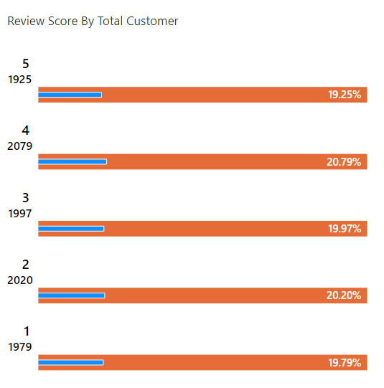
Customer Demographics Overview
Avg Review : 3
Review scores are distributed across 5 rating levels (1 to 5) with a total of 10,000 customer reviews — each score level capturing approximately 20% of all customers
Score 4 leads with 2,079 customers (20.79%) — the highest single rating count — suggesting a slight positive lean in customer sentiment however the margin over other scores is negligible
Score 2 ranks second with 2,020 customers (20.20%) — surprisingly close to Score 4 — indicating the customer base is simultaneously satisfied and dissatisfied in almost equal measure with no clear dominant sentiment.
Score 3 (Neutral) records 1,997 customers (19.97%) — nearly one-fifth of all customers rate their experience as completely neutral — neither positive nor negative — signaling a large undecided customer segment with conversion potential.
Score 1 (Worst) captures 1,979 customers (19.79%) — almost identical to Score 5 — meaning as many customers are completely dissatisfied as are completely satisfied — a deeply concerning balance for long-term business health.
1,979 customers rating Score 1 represents a serious churn risk.
Equal distribution across all 5 scores in synthetic data masks a critical need — the business must implement genuine review collection and sentiment analysis to understand true customer satisfaction drivers before designing improvement strategies.

Slide 9
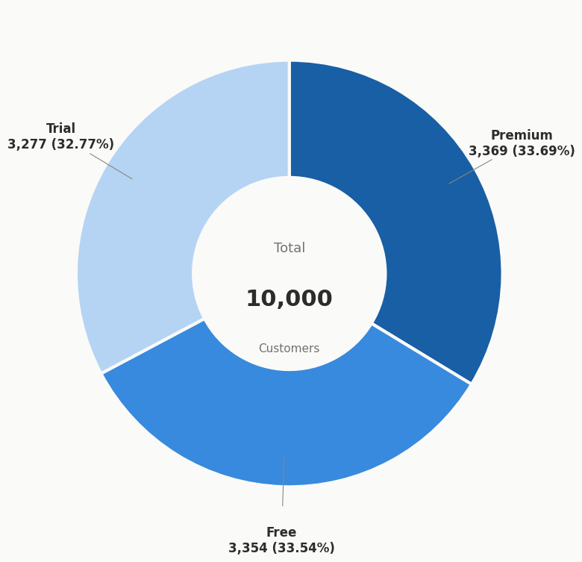
Customer Demographics Overview
How many customers are subscribed to the service?
Premium leads with 3,369 customers (33.69%) — the highest share among all three tiers but only marginally ahead of the other two.
Free ranks second with 3,354 customers (33.54%) — a difference of only 15 customers separating it from Premium status.
Trial records 3,277 customers (32.77%) — the lowest share but still within 92 customers of the leading Premium segment.
The maximum gap between the highest (Premium 33.69%) and lowest (Trial 32.77%) subscription status is only 0.92 percentage.
Conversion Opportunity: Around 66.31% of users are still non-paying (Free + Trial), creating strong potential for conversion-focused marketing.
Even Tier Weighting: No single subscription tier dominates the platform. Operational, customer support, and product engagement efforts must be balanced equally across all three segments to ensure a seamless lifecycle progression from Trial to Premium.

Slide 10

Customer Demographics Overview
What percentage of customers used devices to make purchases?
Mobile leads with 3,374 customers (33.74%) — the highest share among all three devices but only marginally ahead of the other two
Desktop ranks second with 3,348 customers (33.48%) — a difference of only 26 customers separating it from Mobile usage
Tablet records 3,278 customers (32.78%) — the lowest share but still within 96 customers of the leading Mobile segment.
The maximum gap between highest (Mobile 33.74%) and lowest (Tablet 32.78%) device usage is only 0.96 percentage points — confirming near-perfect uniform distribution across all channels
Business implication → Equal distribution across all three devices demands a fully responsive cross-platform strategy — no single channel can be prioritized over others without risking customer experience for one-third of the user base
Strategic recommendation → Invest equally in Mobile, Desktop and Tablet UX optimization — any channel-specific neglect would directly impact approximately 3,300 customers (33%) of the total base

Slide 11
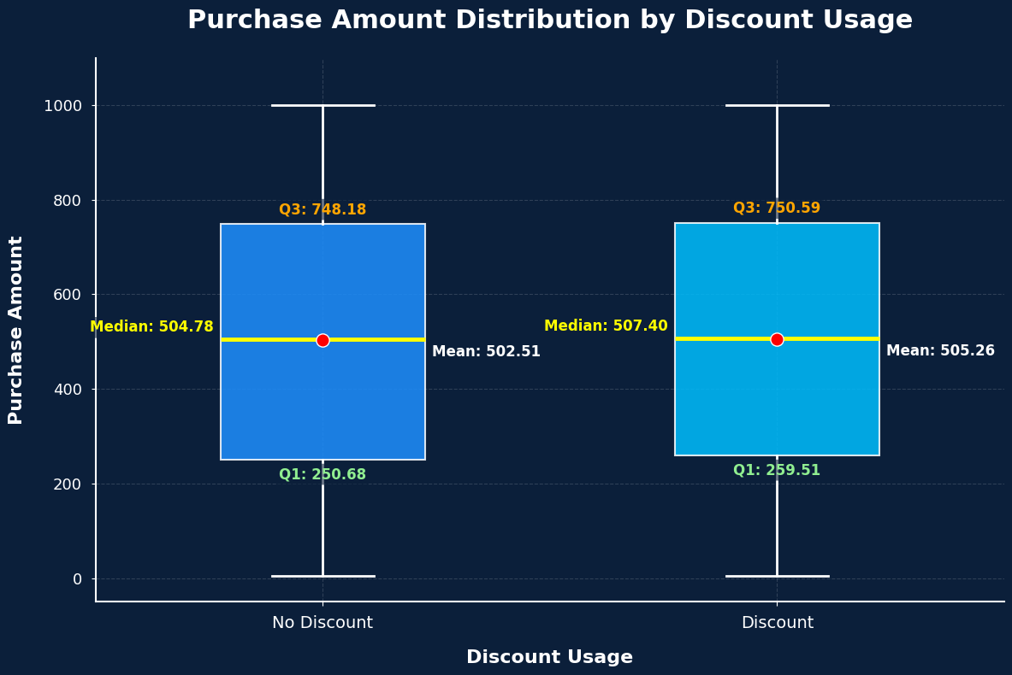
What is the average purchase amount for customers who availed discounts compared
to those who didn't?
Customers with discounts spent an average of $505.26 (Mean) with a median of $507.40 — while customers without discounts spent $502.51 (Mean) with a median of $504.78 a difference of only $2.75 in mean and $2.62 in median across 10,000 customers
Q1 comparison reveals discount customers enter the spending range at $259.51 versus non-discount customers at $250.68 a gap of only $8.83 at the lower spending boundary confirming discounts provide no meaningful uplift even among the lowest spenders
Q3 comparison shows discount customers reach $750.59 at the upper spending boundary versus $748.18 for non-discount customers, a difference of just $2.41 confirming that even high-spending customers are not influenced by discount availability
Both groups share identical whisker range of approximately $0 to $1,000 the full spread of purchase amounts is virtually identical between discounted and non-discounted customers meaning discount usage has zero influence on the overall spending range or distribution shape

Slide 12
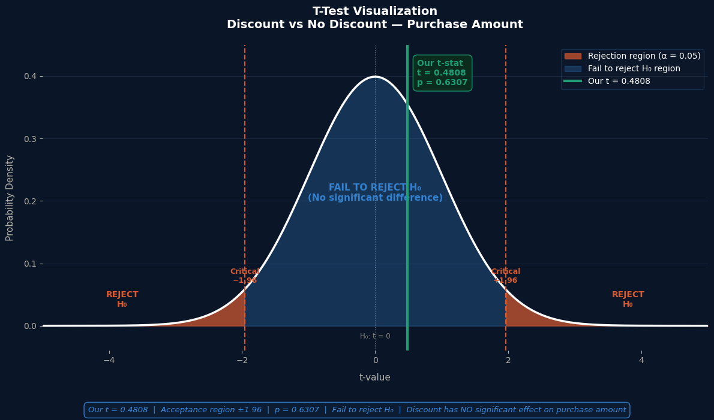
What is the average purchase amount for customers who availed discounts compared
to those who didn't?
The t-test compares two groups customers who used a discount and customers who did not — to answer one business question: "Does offering a discount actually change how much a customer spends?“
Our t-statistic = 0.4808 — this value sits well inside the blue acceptance zone between the two red critical lines at ±1.96 — meaning the difference between the two groups is too small to trust as a real pattern
p-value = 0.6307 means there is a 63% probability that the $2.75 spending gap between discount and non-discount customers happened purely by random chance — not because of the discount itself — similar to flipping a coin and getting heads three times in a row — it looks like a pattern but it is just luck
The two red rejection zones on either side represent where our result would need to land to call the discount effective — our green line at t = 0.4808 never comes close to either red zone — confirming the discount produces no measurable spending impact
Fail to Reject $H0: A 20% coupon yielded no meaningful lift, increasing average spend by a mere $2.75 ($505.26 vs. $502.51).

Slide 13
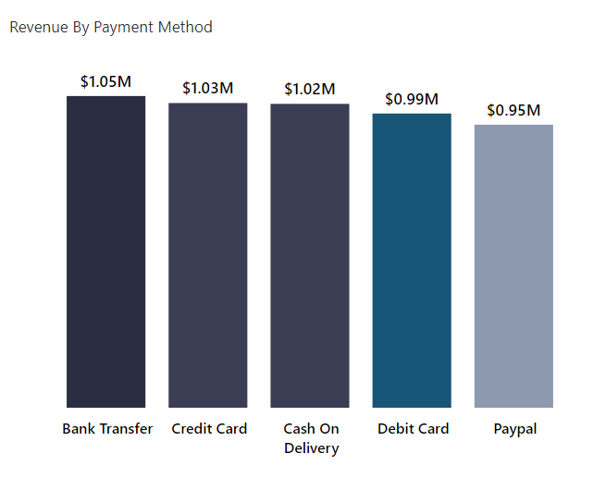
Payment Analysis : What is the most common payment method used by customers?
Bank Transfer ranks #1 in both customers (2,067 / 20.7%) and revenue ($1.05M) — the most dominant payment channel overall, making it the top priority for business reliability and optimization
Credit Card is #2 in both metrics — 2,028 customers (20.3%) generating $1.03M — high-value, trustworthy customers who are comfortable with digital transactions and likely to spend more per order
Cash on Delivery holds #3 position — 2,007 customers (20.1%) and $1.02M revenue — despite being an offline method, it contributes significantly, meaning businesses cannot afford to drop it
Debit Card users (1,983 customers / 19.8%) generated $0.99M — slightly lower revenue per customer compared to Credit Card, reflecting more budget-conscious spending behavior
PayPal ranks last in both customers (1,915 / 19.2%) and revenue ($0.95M) — the lowest performing channel, yet still nearly $1M, indicating it should be retained but actively promoted to grow adoption
Total revenue across all methods is approximately $5.03M — with a near-perfect even split, no single method carries disproportionate business risk
Business recommendation — focus on converting Cash on Delivery ($1.02M) to digital methods, as COD increases return risk and logistics cost despite generating strong revenue

Slide 14
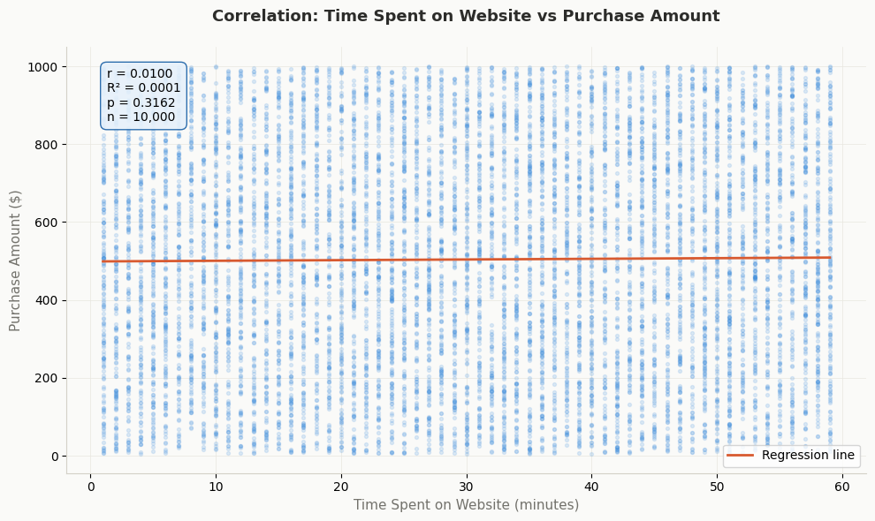
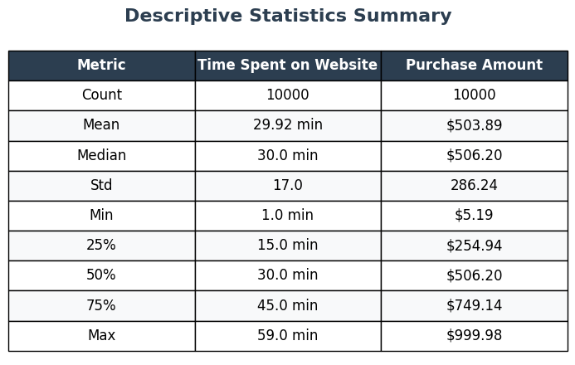
What is the correlation between time spent on the website and purchase amount?

Slide 15
What is the correlation between time spent on the website and purchase amount?
Pearson r = 0.0100 — essentially zero, meaning there is no linear relationship between time spent on the website and purchase amount
R² = 0.0001 — time spent on the website explains only 0.01% of the variation in purchase amount — practically zero explanatory power
P-Value = 0.3162 — greater than 0.05, meaning this result is not statistically significant and could simply be random chance
The regression line is completely flat — confirming that as time spent increases from 1 to 60 minutes, purchase amount does not increase or decrease at all.
The dots are randomly and evenly scattered from top to bottom at every time interval — no pattern, no clustering, no trend
There is no meaningful correlation between how long a customer browses and how much they spend — longer sessions do not convert into higher revenue
This suggests the website may have a product discovery or UX problem — customers are not being guided toward higher value purchases during longer sessions
The business should investigate why customers browse long without spending more — better recommendation engines, personalized offers, or improved navigation could help convert browsing time into revenue.

Slide 16
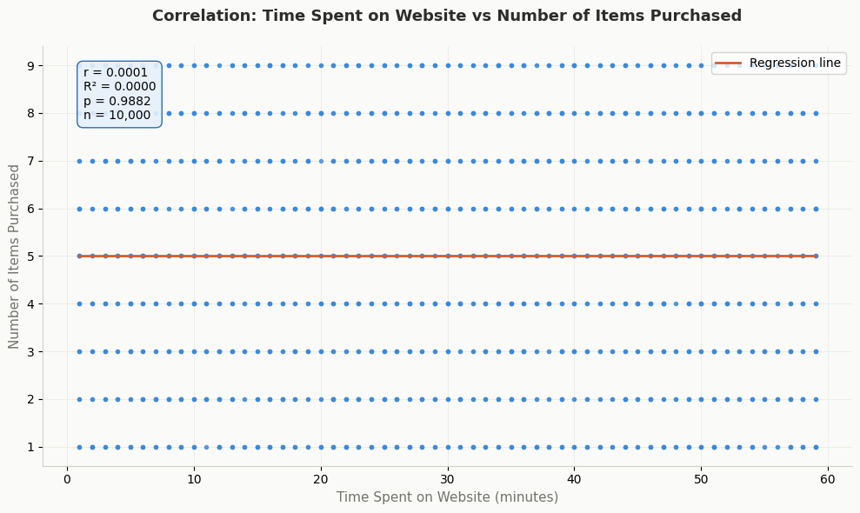
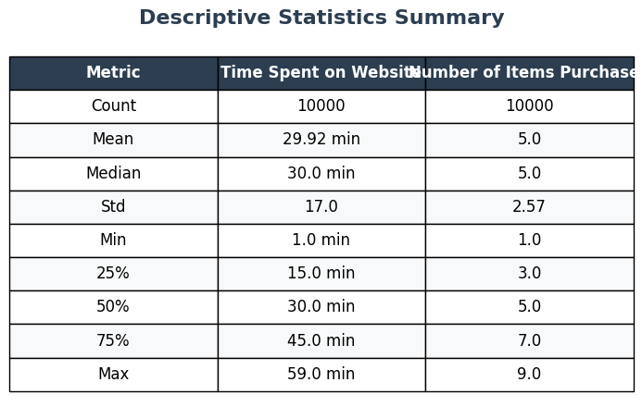
Do customers who spend more time on the website purchase more items?

Slide 17
Do customers who spend more time on the website purchase more items?
Average number of items purchased is 5.0 (median 5.0) — the dead-center median suggests items purchased is uniformly distributed with no skew
Items purchased ranges from 1 to 9 with a std of 2.57 — customers buy anywhere between 1 and 9 items with an average spread of about 2–3 items either side of the mean.
Bottom 25% of browsers spend up to 15 minutes and still buy up to 3 items — short sessions still produce multi-item purchases
Top 25% of browsers spend 45+ minutes and buy up to 7 items — but this is identical to the overall distribution, not a unique pattern driven by time.
r = 0.0001 — the correlation is so close to zero it is essentially non-existent, meaning time spent and items purchased move completely independently of each other
P-value = 0.9882 — this is the highest possible p-value, meaning there is a 98.82% chance this result is purely random — the furthest possible result from statistical significance
The relationship direction is technically Positive but with r = 0.0001 this is meaningless — positive or negative makes no difference at this level
Relationship strength is classified as Negligible — the weakest possible category, confirming no actionable relationship exists
Add "Customers also bought" and "You may also like" sections on every product page.
Use purchase history and browsing behavior to serve personalized suggestions in real time.
Target impact → convert idle browsing time into additional item discovery
Create product bundles (buy 3 get 1 free, bundle deals by category) to encourage larger baskets.
Show "Complete the look" or "Frequently bought together" prompts at checkout
Target impact → increase number of items purchased per session

Slide 18
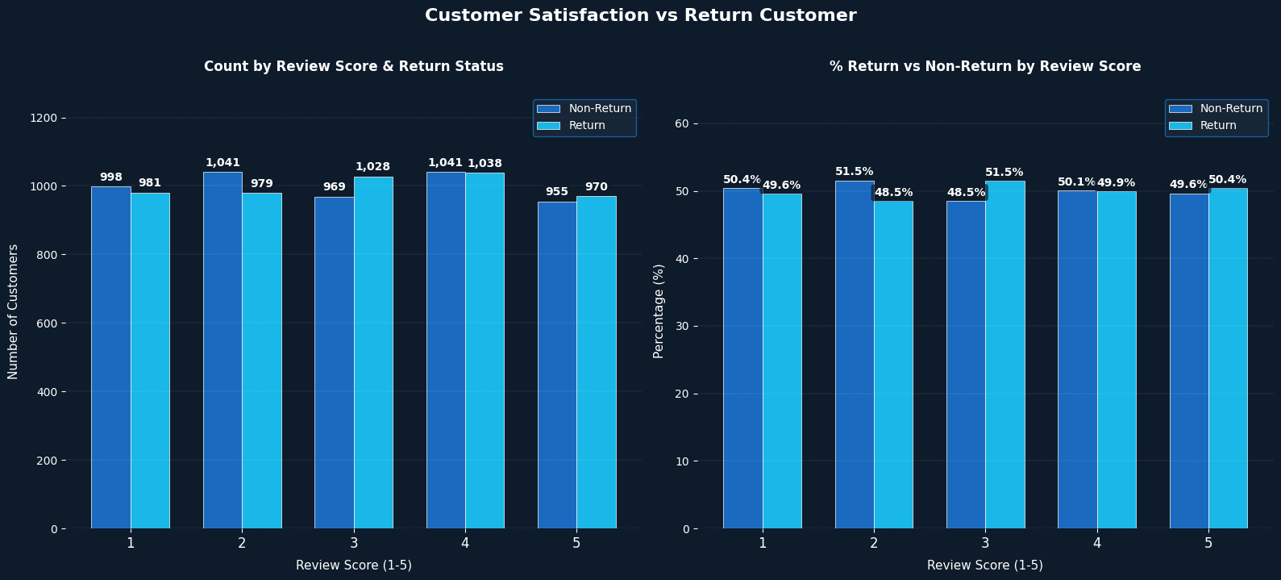
What percentage of customers are satisfied (rating of 4 or 5) and are also return
customers?

Slide 19
Score 1 (most dissatisfied) — Non-Return: 998 (50.4%) vs Return: 981 (49.6%) — even the most unhappy customers return at nearly the same rate as they leave — disproving the assumption that poor experience drives customer loss
Score 4 (most satisfied) — Non-Return: 1,041 (50.1%) vs Return: 1,038 (49.9%) — the highest count score shows the most equal split of all — confirming satisfaction at this level produces zero loyalty advantage
Score 5 (most satisfied) — Non-Return: 955 (49.6%) vs Return: 970 (50.4%) — the highest count score shows the most equal split of all — confirming satisfaction at this level produces zero loyalty advantage
Score 2 shows the largest gap — Non-Return: 1,041 (51.5%) vs Return: 979 (48.5%) — a difference of only 2 percentage points — the widest gap in the entire chart yet still statistically meaningless
Score 3 mirrors Score 2 exactly — Non-Return: 969 (48.5%) vs Return: 1,028 (51.5%) — interestingly neutral customers return slightly more than dissatisfied Score 2 customers — suggesting indifference is less damaging to loyalty than mild dissatisfaction
Maximum return rate gap across all scores = 1.9 percentage points (Score 3 Return 51.5% vs Score 4 Return 49.9%) — statistically confirmed as random noise by Mann-Whitney U test (p = 0.3822) Stop investing in satisfaction scores as a loyalty driver — the data proves that improving review scores from 3 to 5 does not increase the probability of a customer returning — every dollar spent purely on satisfaction improvement without a dedicated re-engagement mechanism is wasted
Build a post-purchase retention system independent of satisfaction — since even Score 5 customers return at only 50.4% — implement automated follow-up sequences triggered 7, 14 and 30 days after purchase regardless of review score — loyalty must be actively cultivated not assumed from happiness
Score 1 customers (981 returning — 49.6%) represent a massive untapped recovery opportunity — nearly half of the most dissatisfied customers still return — a targeted service recovery programme reaching out to Score 1 reviewers with a personalised apology and exclusive offer could convert them into loyal advocates at low cost
Score 2 customers show the lowest return rate (48.5%) — mildly dissatisfied customers are the most likely to quietly leave without complaining — implement a proactive satisfaction rescue campaign specifically targeting Score 2 reviewers before they churn permanently
Score 3 neutral customers return at the highest rate (51.5%) — these undecided customers represent the easiest conversion target — a single well-timed personalised incentive (exclusive discount, loyalty points, product recommendation) could push this segment toward both higher satisfaction AND confirmed repeat purchase
The uniform 50/50 split across all scores signals the business has no loyalty infrastructure — satisfaction is being measured but not acted upon — implementing a Net Promoter Score (NPS) programme with score-based follow-up actions would be the single highest-impact loyalty investment available

Slide 20
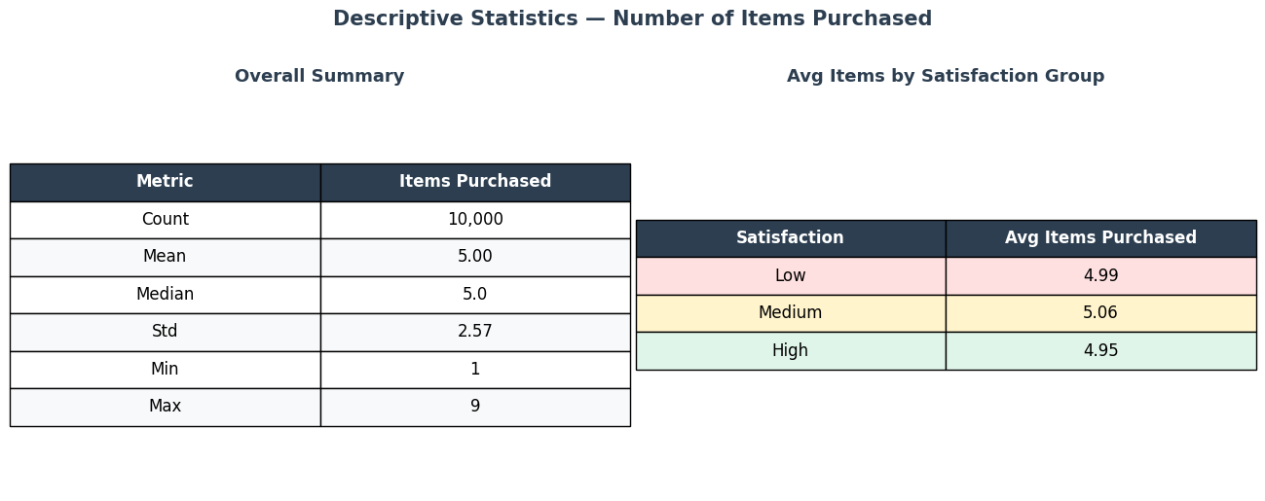
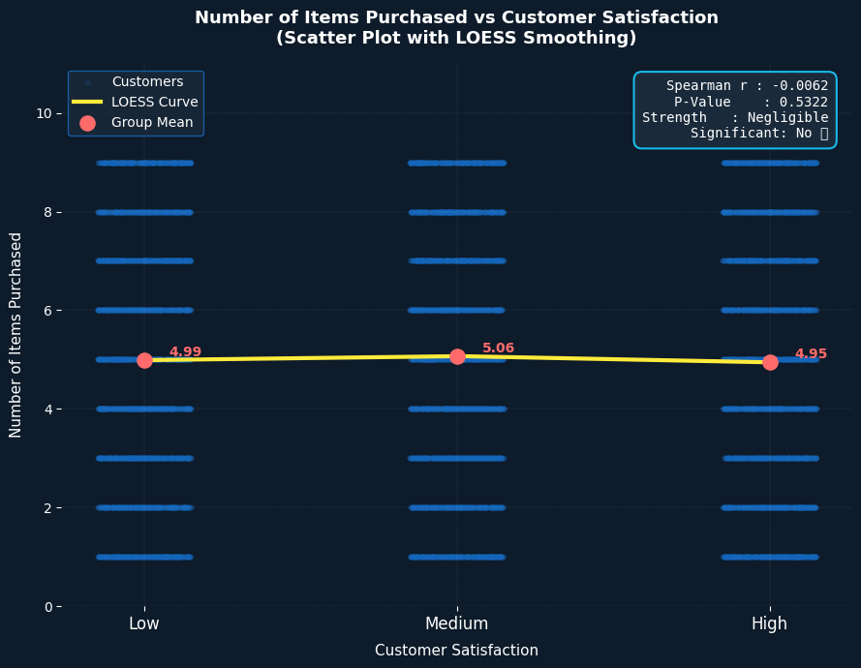
What is the relationship between the number of items purchased and customer
satisfaction?

Slide 21
What percentage of customers are satisfied (rating of 4 or 5) and are also return
customers?
Group mean items purchased across all three satisfaction levels shows virtually no variation — Low satisfaction customers average 4.99 items, Medium satisfaction 5.06 items and High satisfaction 4.95 items — a maximum difference of only 0.11 items across the entire satisfaction spectrum
Spearman correlation r = −0.0062 (p = 0.5322) confirms there is no statistically significant relationship between items purchased and satisfaction level — the negative r value reveals that High satisfaction customers actually purchase marginally fewer items than Low satisfaction customers — directly contradicting the common retail assumption
The LOESS smoothing curve — which traces the actual trend through 10,000 data points — is virtually flat across all three satisfaction groups — rising only 0.07 items from Low to Medium before dropping 0.11 items to High — confirming no meaningful directional trend exists between basket size and customer happiness
The Spearman correlation heatmap confirms this finding at a broader level — Items Purchased shows correlations of 0.01 or less with every other variable in the dataset including Purchase Amount, Time on Website, Review Score, Age and Delivery Days — proving that basket size is completely independent of every measured customer behaviour in this dataset

Slide 22
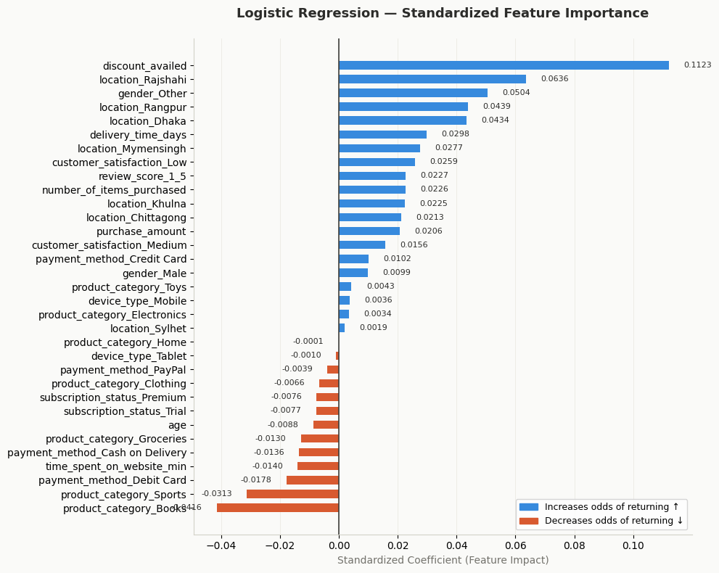
What factors contribute most to a customer being classified as a return customer?

Slide 23
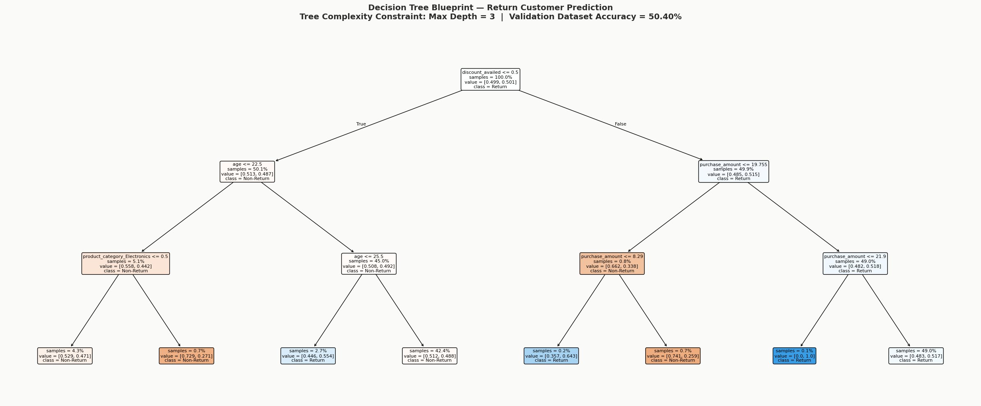
What factors contribute most to a customer being classified as a return customer?

Slide 24
Discounts are the #1 trigger — Logistic Regression and the Decision Tree both agree: customers who used a discount are significantly more likely to return. This is your single most actionable retention lever right now.
How much they spend matters most in reality — Random Forest (the most powerful model) ranked purchase_amount #1 at 15.41%. High-spending customers are your most loyal segment — they return because they're already invested.
Time on website is a strong loyalty signal — Customers who browse longer (12.05% RF importance) are more likely to return. This reflects genuine interest, not just impulse buying.
Age drives return behavior non-linearly — RF ranked age #3 at 11.24%. Customers aged 23–25 showed the strongest return lean in the Decision Tree. Middle-age segments behave differently than younger/older ones .
Delivery experience influences loyalty — delivery_time_days ranked #4 in RF (8.71%). Surprisingly, longer delivery still correlates positively — customers may be tolerant if other factors satisfy them.
Location creates loyalty clusters — Rajshahi, Dhaka, and Rangpur customers return more often per LR. Geographic loyalty patterns suggest regional differences in shopping behavior. Launch a discount-based loyalty program — Since discounts are the strongest universal return trigger across 2 of 3 models, structured repeat-purchase coupons or member-exclusive discounts will directly increase return rates. Focus retention efforts on high-spend customers — Purchase amount is the most powerful real-world predictor. Identify your top spenders and target them with VIP perks, early access, or personalized offers before they go quiet. Run geo-targeted campaigns in Rajshahi, Dhaka & Rangpur — These locations already show natural loyalty. Double down with regional promotions, faster delivery, or local partnerships to amplify what's already working.

Slide 25
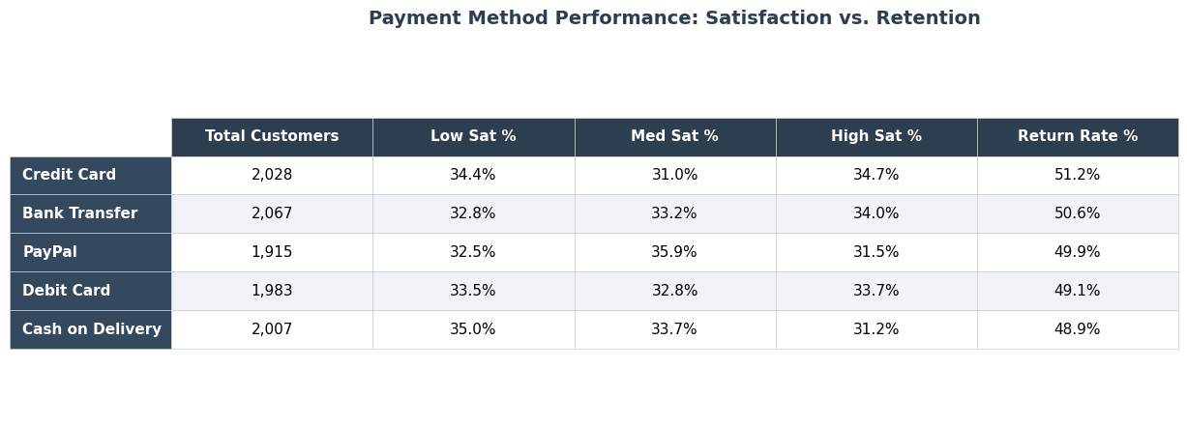
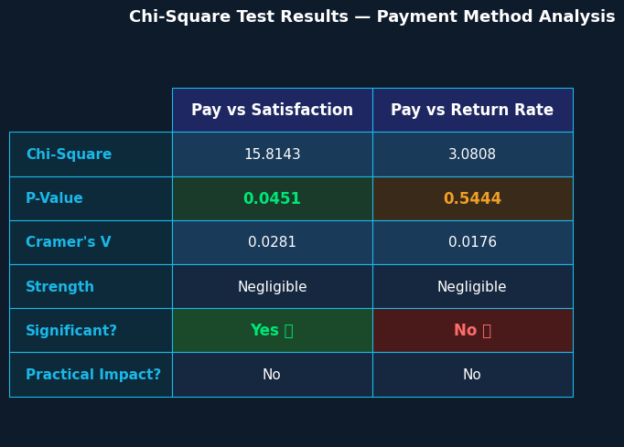
How do payment methods influence customer satisfaction and return rates?

Slide 26
Credit Card leads both metrics — highest High Satisfaction rate at 34.7% and highest Return Rate at 51.2% — suggesting that customers who pay by credit card have a marginally smoother and more confident purchasing experience compared to other payment channels
Cash on Delivery performs worst across both indicators — highest Low Satisfaction rate at 35.0%, lowest High Satisfaction at 31.2% and lowest Return Rate at 48.9% — a consistent pattern suggesting the cash payment experience creates the most friction and leaves customers least satisfied and least likely to return.
Payment vs Satisfaction is statistically significant (χ² = 15.8143, p = 0.0451) — confirming a real relationship exists between payment method choice and satisfaction level — however Cramer's V = 0.0281 (Negligible) reveals the practical impact is minimal — payment method explains only 0.08% of satisfaction variation
Payment vs Return Rate is NOT significant (χ² = 3.0808, p = 0.5444) — confirming that payment method choice has absolutely no influence on whether a customer returns — a Credit Card user and a Cash on Delivery user are equally likely to come back regardless of their payment experience
The 2.3 percentage point gap in return rate between Credit Card (51.2%) and Cash on Delivery (48.9%) — while the largest observed difference — is statistically confirmed as random noise (p = 0.5444) — meaning no payment method meaningfully drives customer loyalty in either direction. Prioritize Credit Card and Bank Transfer checkout optimization — these two methods together serve 4,095 customers (41% of total) and show the highest satisfaction and return rates — any friction in these payment flows directly impacts the business's most loyal customer segment — invest in one-click payment, saved card features and instant confirmation to protect this revenue base
Urgently investigate the Cash on Delivery experience — with the highest dissatisfaction rate (35.0% Low Satisfaction) and lowest return rate (48.9%) Cash on Delivery is the business's weakest loyalty channel — implement real-time delivery tracking, SMS confirmation and flexible rescheduling to reduce the uncertainty and frustration that COD customers experience
Convert Cash on Delivery customers to digital payments — offer a 5% loyalty bonus or priority delivery for customers who switch from COD to Credit Card or Bank Transfer — this would simultaneously reduce operational cash handling costs and improve the customer's payment experience — directly addressing the satisfaction gap
PayPal shows highest Medium Satisfaction (35.9%) but lowest High Satisfaction (31.5%) — PayPal customers are neutrally satisfied but not delighted — implementing PayPal-exclusive offers or instant cashback could push this segment from neutral to highly satisfied — converting 35.9% medium satisfaction into high satisfaction represents 688 customers with immediate upsell potential
Since payment method does not drive return rate — the business should stop investing in payment-specific loyalty programmes and instead focus on post-purchase retention mechanisms that work independently of payment channel — a universal loyalty points system, personalised follow-up emails and exclusive member offers would deliver higher return rate impact than any payment-specific initiative

Slide 27
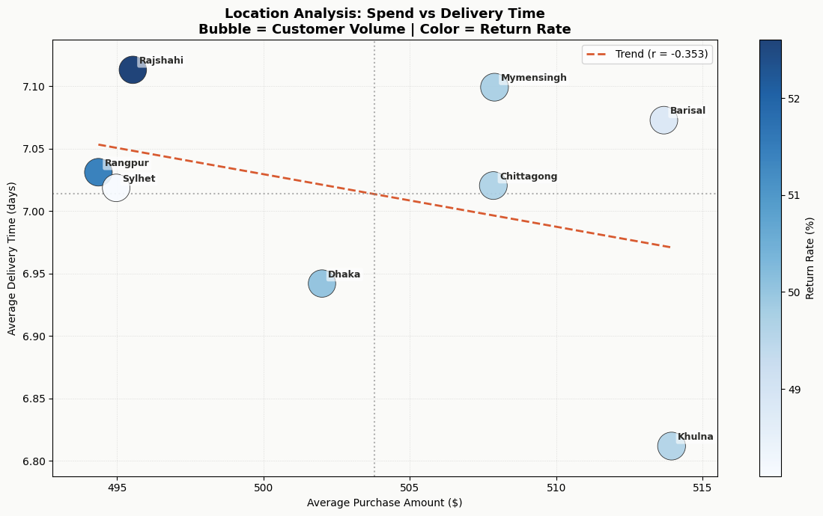
How does the location influence both purchase amount and delivery time?

Slide 28
How does the location influence both purchase amount and delivery time?
Negative correlation (r ≈ -0.353) shows higher spend slightly links to faster delivery.
Rajshahi shows high delivery time with higher return rate concern.
Mymensingh has slow delivery despite high spend levels.
Barisal combines high spend with slower delivery performance.
Chittagong shows high spend but not optimal delivery speed.
Rangpur has low spend with average delivery performance.
Sylhet shows low spend with slightly better delivery balance.
Khulna shows fast delivery but highest spend levels.
Higher return rates cluster around slower delivery regions.
Delivery performance is not strongly driven by customer spend.
Improving logistics in slow regions can reduce returns and increase value.

